Slide 1
Depolarizing effect of strategic anti-conformity insights from the three-state q-voter model with bounded confidence
Katarzyna Sznajd-Weron
Faculty of Management
MMM ETH Workshop

Slide 2
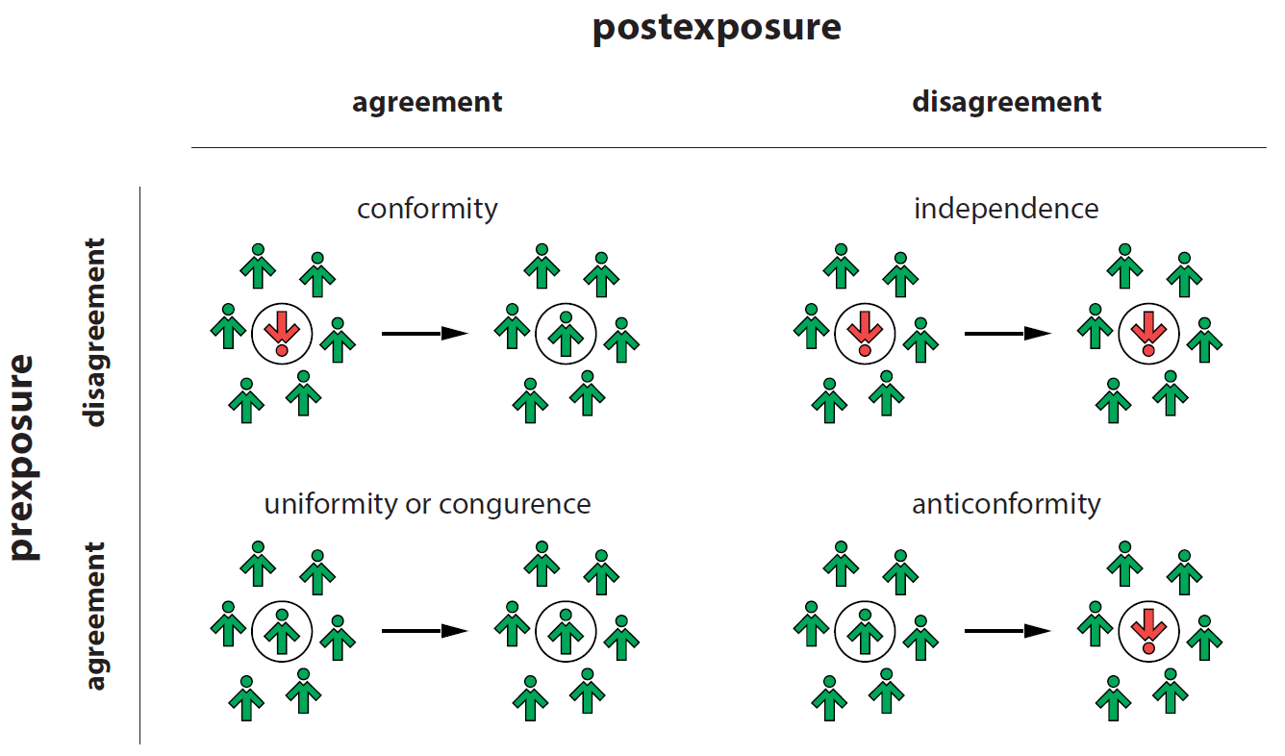
), 6098
What is (strategic) anticonformity?
Nail, P.R., Sznajd-Weron, K. (2016) Rethinking the diamond model: Theory and research support self-anticonformity as a basic response and influence process, in "The Psychology of Consumer and Social Influence: Theory and Research”

Slide 3
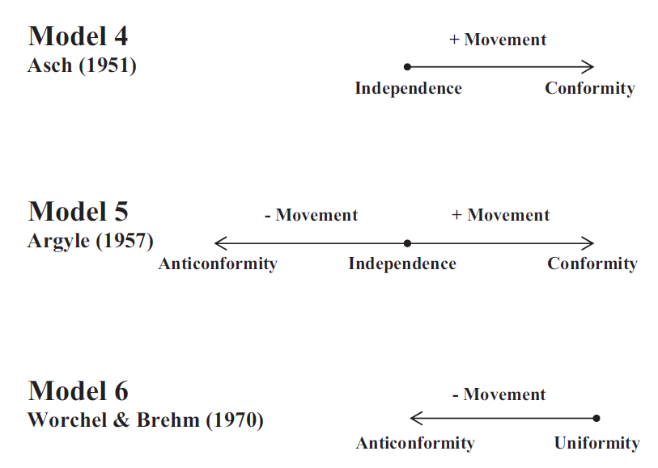
), 6098
What is (strategic) anticonformity?
Paul R. Nail et al. (2013) Proposal of a Double Diamond Model of Social Response Review of General Psychology

Slide 4


), 6098
What is strategic anticonformity?
Advocating for a behavior that is different than the desired outcome
The goal is to encourage the other person to do what is actually desired
Sushi ….
Steak or sushi?
Maybe steak?
MacDonald G, Nail PR, Harper JR (2011) Do people use reverse psychology? An exploration of strategic self-anticonformity. Social Influence

Slide 5
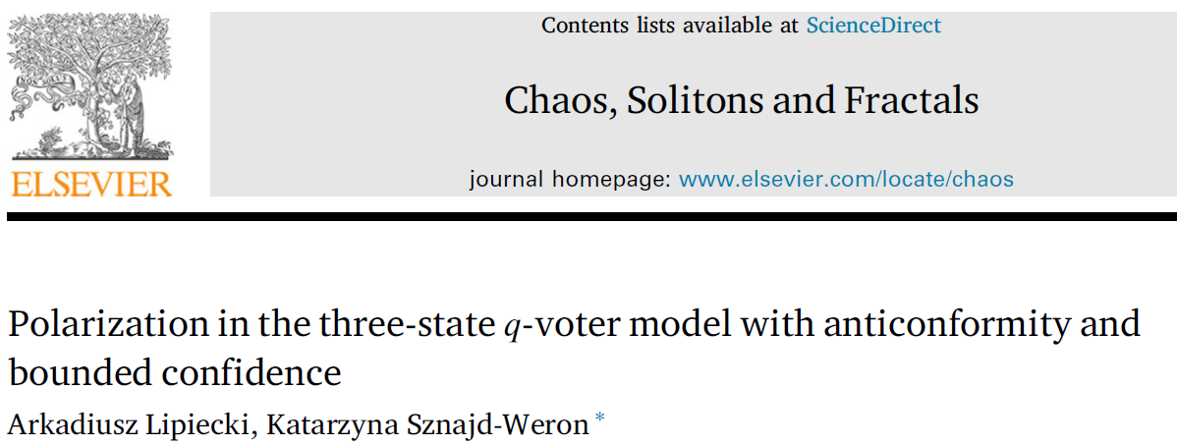

), 6098

Slide 6

), 6098
Motivation
„One of the most difficult challenges leaders of all organizations face is managing diverse perspectives”

Slide 7





), 6098
Decision making
Example 1: teaching at the Wroclaw Tech (post Covid)
remote
hybrid
stationary
1
2
3

Slide 8
), 6098
Opinion distributions (N=12)
Average opinion:
…
polarization

Slide 9
), 6098
Questions:
Can strategic anticonformity depolarize the system?
Why is the system polarized?

Slide 10
), 6098
Many conflicts grow as people on both sides talk mostly with like-minded others.
David G. Myers (2010), Social Psychology, 10th Edition,
Page 282

Slide 11
), 6098
The three-state model
1
2
3
Assumptions:
1) Ordered/ranked opinions
(2 extreme, 1 moderate)
2) Change only by one unit
(MAYA = Most Advanced, Yet Acceptable)
Linear voter model: Vazquez F, Krapivsky PL, Redner S. (2003) Constrained opinion dynamics: freezing and slow evolution.

Slide 12
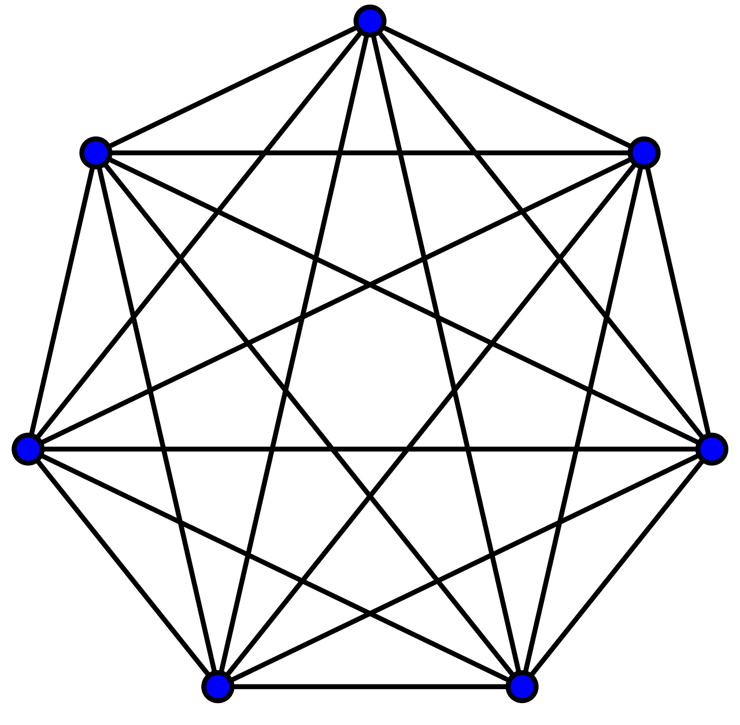
), 6098
The three-state q-voter model
2
1
2
no unanimity
no influence
3
3
2
3
Source of influence = q-panel
Ex: q=3

Slide 13
), 6098
The three-state q-voter model
2
1
2
unanimity
influence
3
3
2
3
Source of influence = q-panel
Ex: q=3

Slide 14
), 6098
Conformity + bounded confidence
2
1
2
too different
no influence
3
3
2
3
Source of influence = q-panel
Ex: q=3

Slide 15
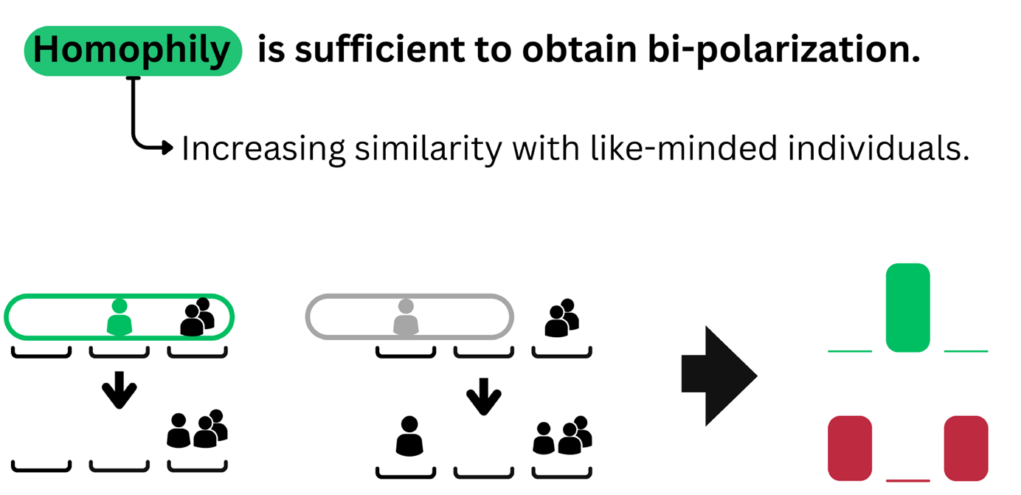
), 6098
Conformity + bounded confidence
(c) A.Lipiecki, 2023
Mäs M, Flache A. (2013) Differentiation without distancing, explaining bi-polarization of opinions without negative influence. PLoS One

Slide 16
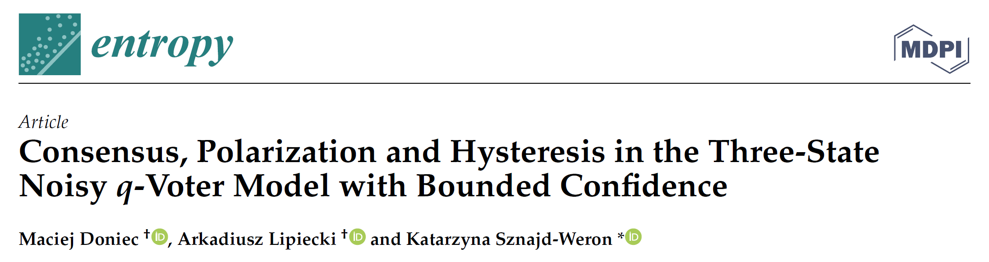
), 6098

Slide 17
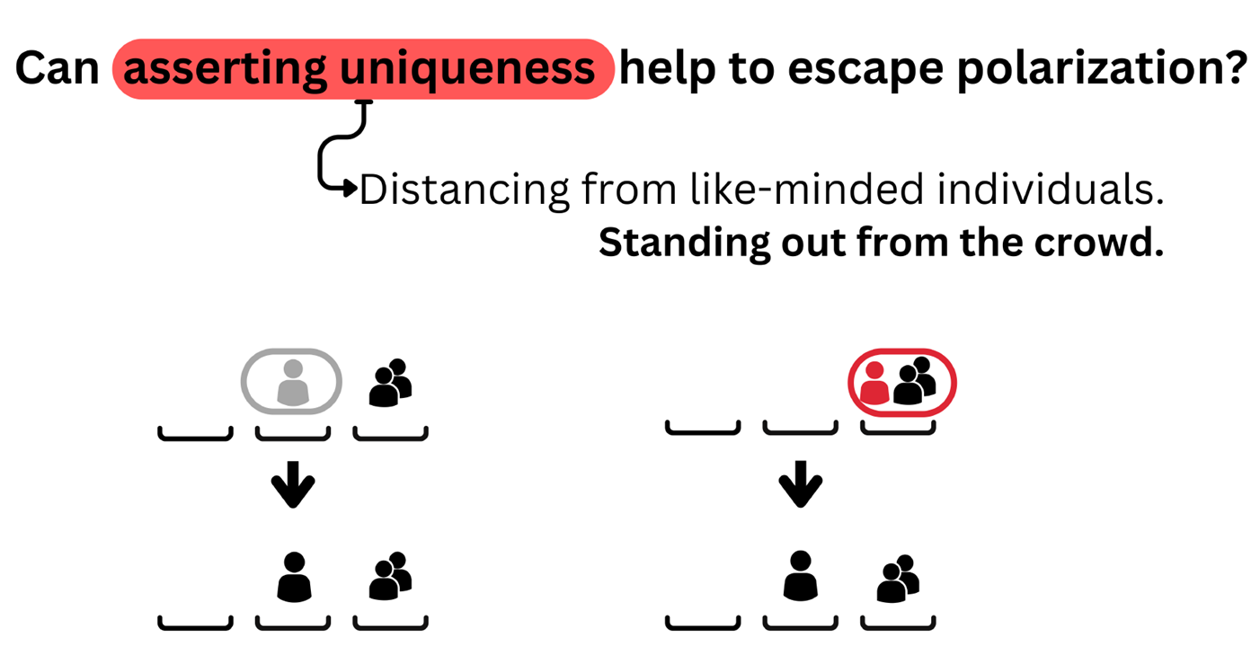
), 6098
Anticonformity + bounded confidence
(c) A.Lipiecki, 2023
Grabisch M, Li F. (2020) Anti-conformism in the Threshold model of collective behavior. Dynam Games Appl

Slide 18
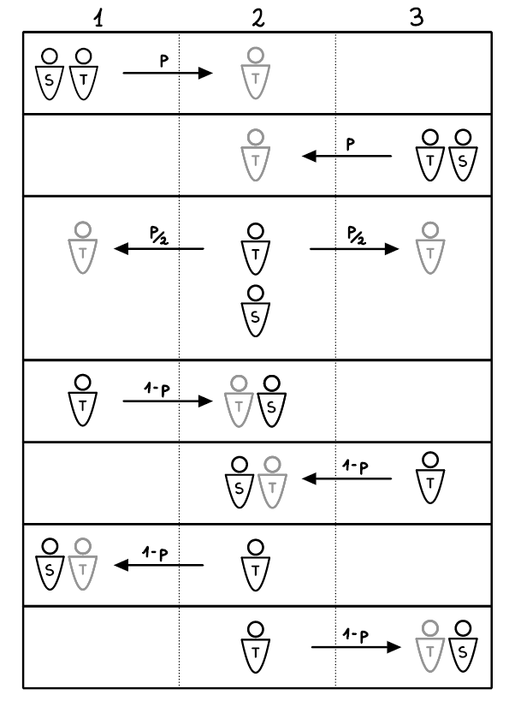
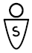
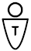

), 6098
All possible changes
Legend:
Source: q-panel
Target „before”
Target „after”
Lipiecki, A., Sznajd-Weron, K. (2022) Chaos, Solitons and Fractals

Slide 19
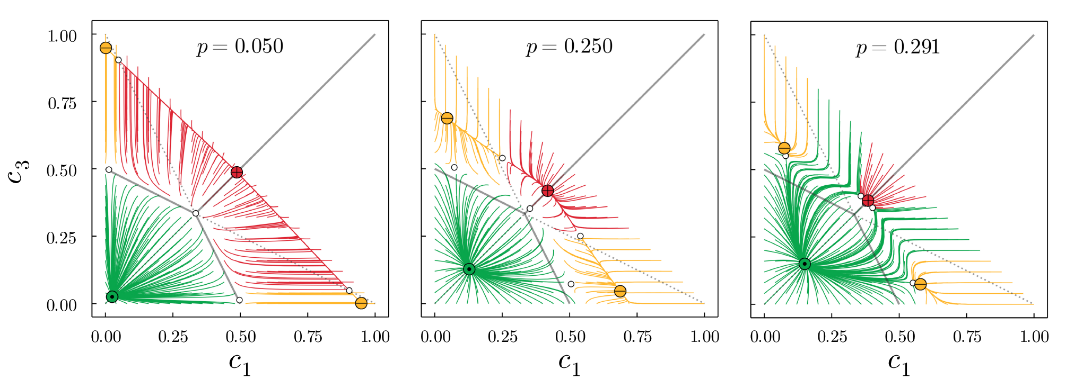
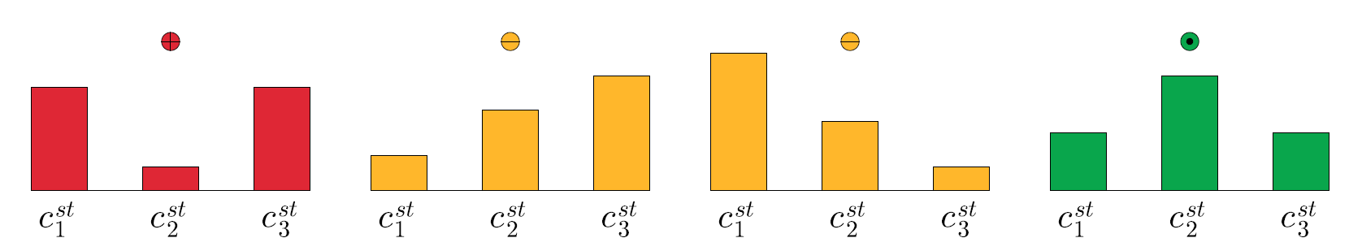
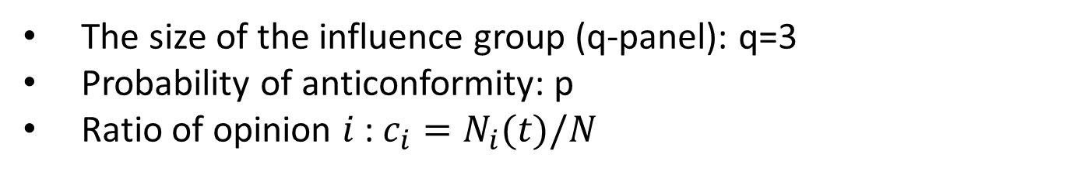
), 6098
Results on the complete graph
The size of the influence group (q-panel): q=3
Probability of anticonformity: p
Ratio of opinion $i$ : $c_{i}=N_{i}(t)/N$

Slide 20
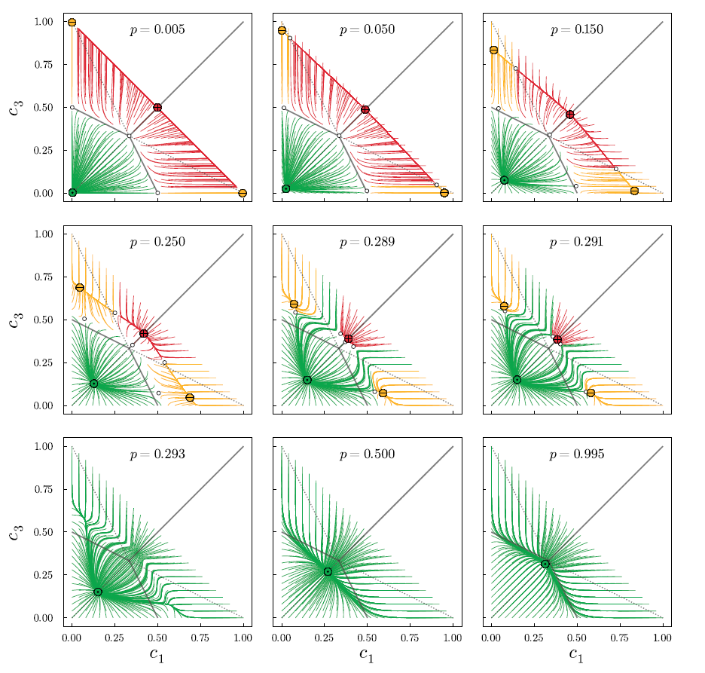
), 6098
Critical p for agreement

Slide 21
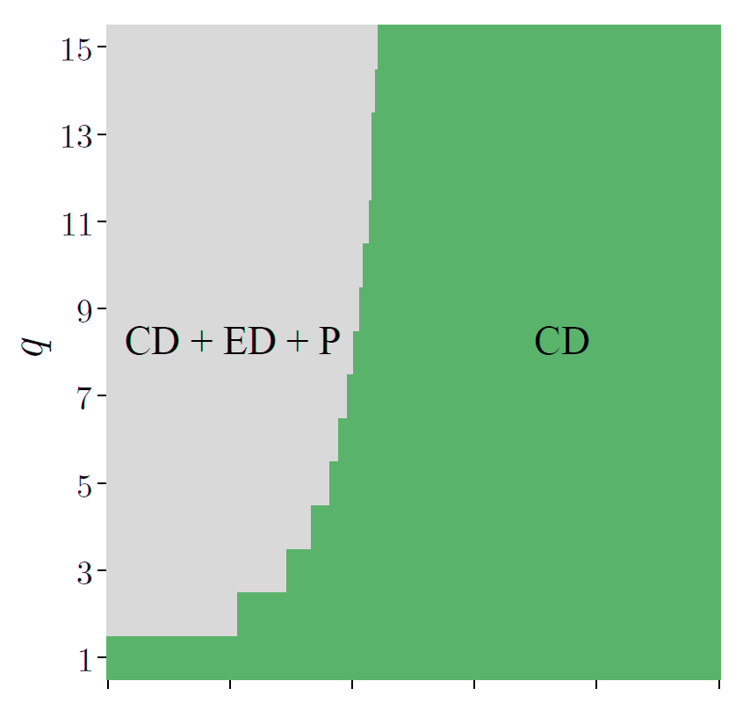
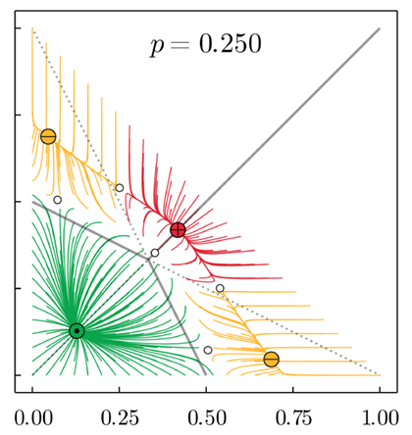
), 6098
How important is the influence group?
P+ED+CD
CD
Size of the influence group: q
Probability of aniconformity: p

Slide 22
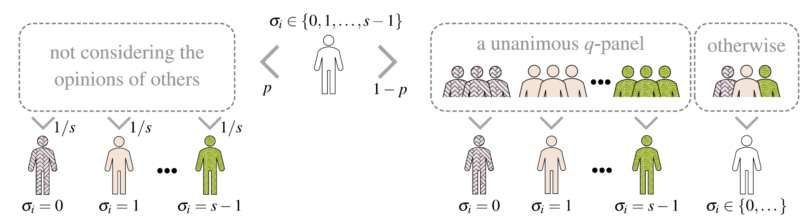
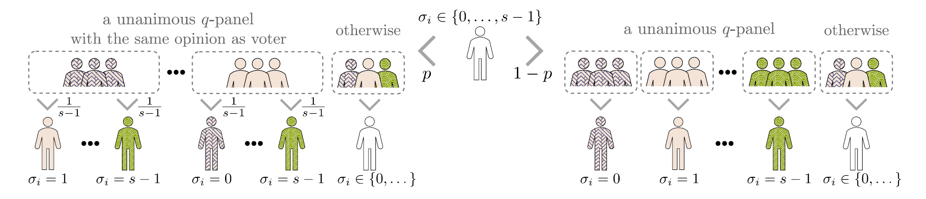
), 6098
How important are model details?
Nowak, B., Stoń, B., Sznajd-Weron, K. (2021) ScieRep 11(1), 6098
Nowak, B., Sznajd-Weron, K. (2022) Physical Review E 106(1), 014125

Slide 23
), 6098
No polarization without homophily!

Slide 24


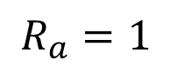
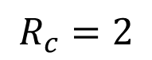
), 6098
General model with anticonformity
Conformity = positive, attractive
$$R_{c}=2$$
Anticonformity = negative, repelling
$$R_{a}=1$$
Lipiecki, A., Sznajd-Weron, K. (2022) Polarization in the three-state q-voter model with anticonformity and bounded confidence, Chaos, Solitons and Fractals
Grabisch M, Li F. (2020) Anti-conformism in the Threshold model of collective behavior. Dynam Games Appl

Slide 25
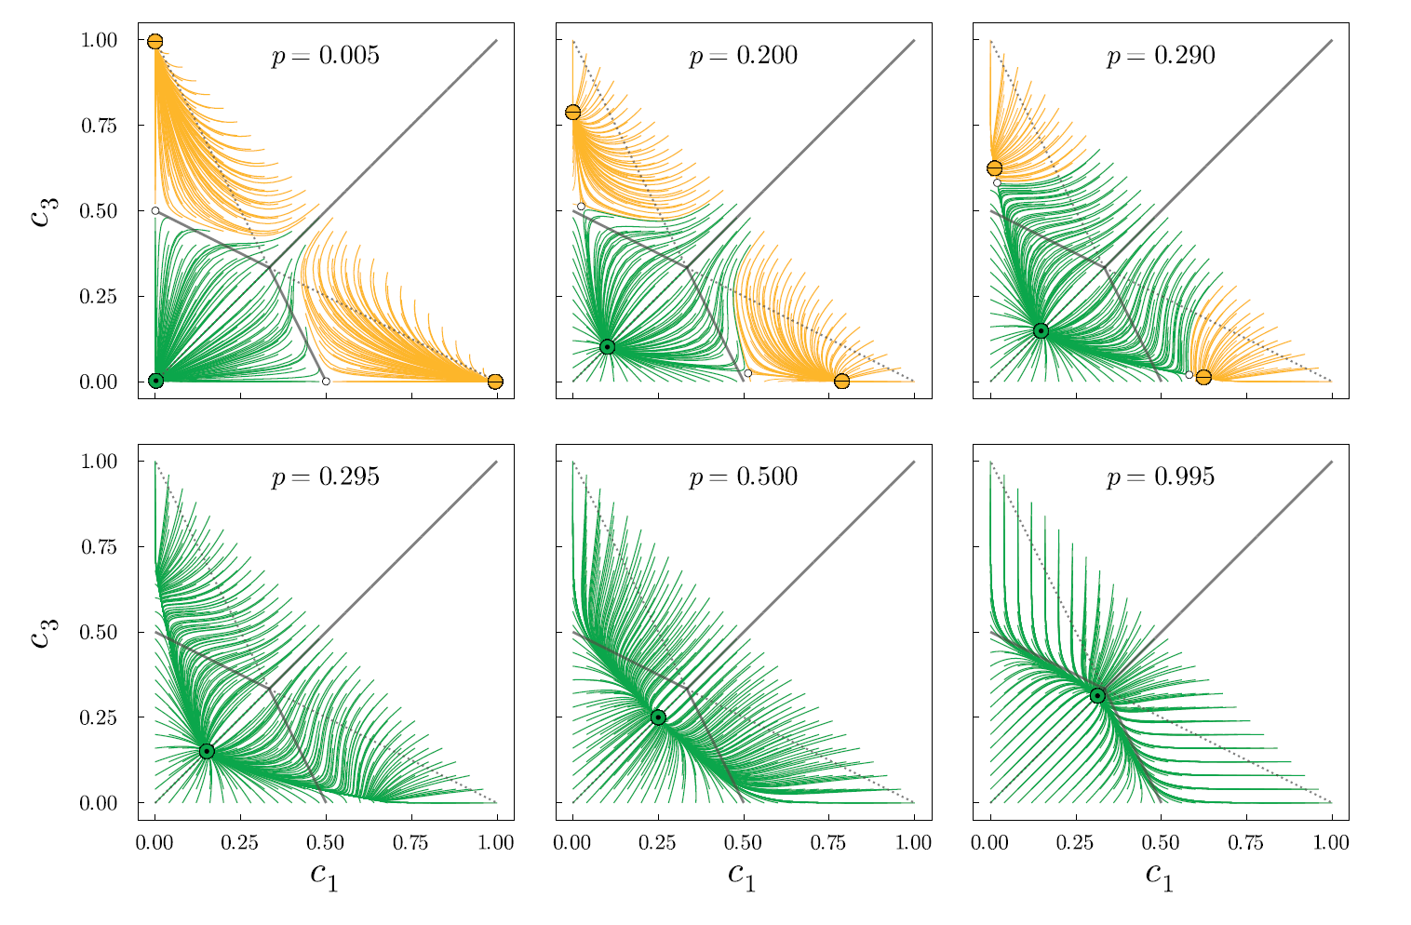
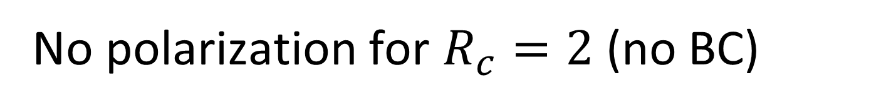
), 6098
No polarization for $R_{c}=2$ (no BC)

Slide 26
), 6098
So far …
One community
Can we depolarize it?
Coming soon …

Slide 27

), 6098
Summary
No polarization without homophily (BC) [1,3,4]
Shift by one (MAYA) is not needed for polarization [2]
No extreme dominance without anticonformity [1,2]
Smaller anticonformity = larger polarization [1]
Polarization (social psychology) is a process …
Critical level of anticonformity for agreement [1]
Literature on non-binary q-voter model
[1] Lipiecki, A., Sznajd-Weron, K. (2022) Chaos, Solitons and Fractals
[2] Doniec, M., Lipiecki, A., Sznajd-Weron, K. (2022) Entropy
[3] Nowak, B., Sznajd-Weron, K. (2022) Physical Review E
[4] Nowak, B., Stoń, B., Sznajd-Weron, K. (2021) Scientific Reports

Slide 28

), 6098
Decision making
Example 2: Wildlife control method
(1) doing nothing
(2) nonlethal
(3) lethal

Slide 29
), 6098
Decision making
Example 2: Wildlife control method
(1) doing nothing
(2) nonlethal
(3) lethal

Slide 30
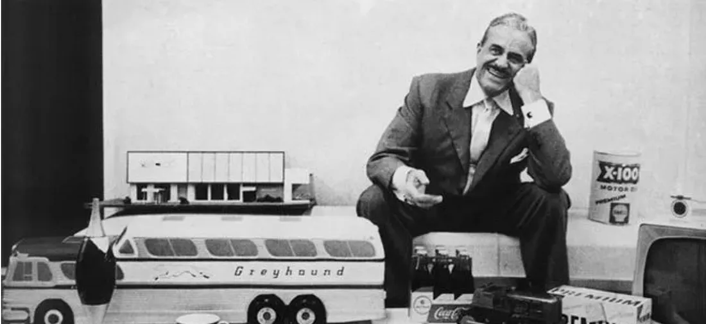
), 6098
The M.A.Y.A. product design principle
“The adult public’s taste is not necessarily ready to accept the logical solutions to their requirements if the solution implies too vast a departure from what they have been conditioned into accepting as the norm.„
— Raymond Loewy (1951)

Slide 31
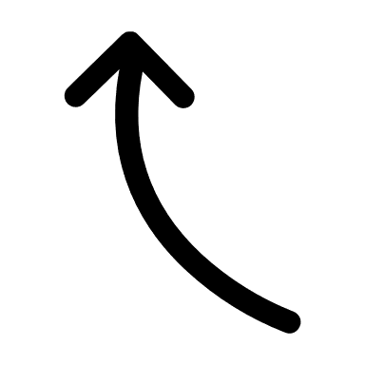
), 6098
Can we depolarize community?

Slide 32
), 6098
Cross-community polarization

